Slide 1

DEFORMABLE DETR: DEFORMABLE TRANSFORMERS
FOR END-TO-END OBJECT DETECTION
Guo Ziqi 2022.04.27
Published as a conference paper at ICLR 2021 from SenseTime Research

Slide 2

01.
Introduction
02.
Background
03.
Method
04.
Experiment
05.
Conclusion

Slide 3
01
INTRODUCTION

Slide 4
02
BACKGROUND

Slide 5
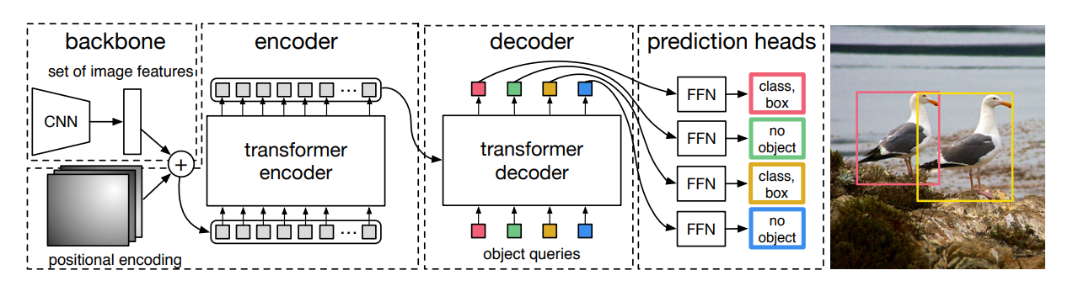
DETR

Slide 6
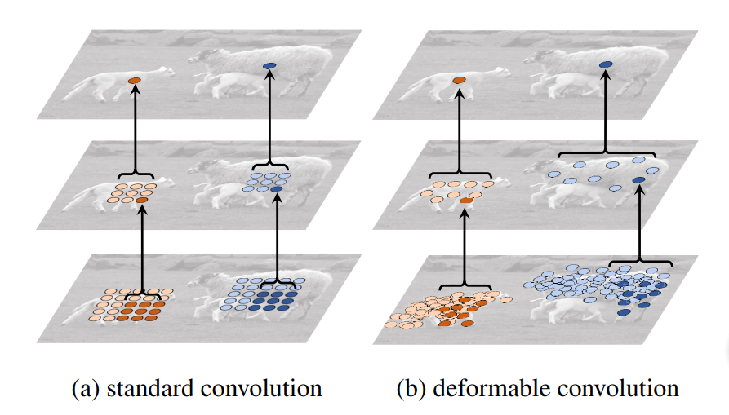
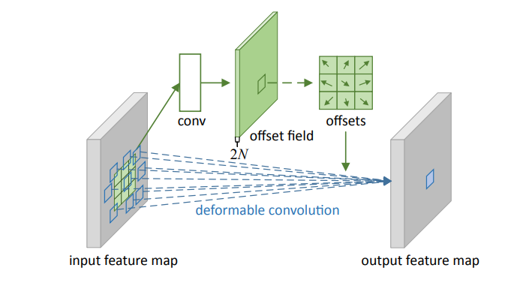
Deformable convolution

Slide 7
03
METHOD

Slide 8
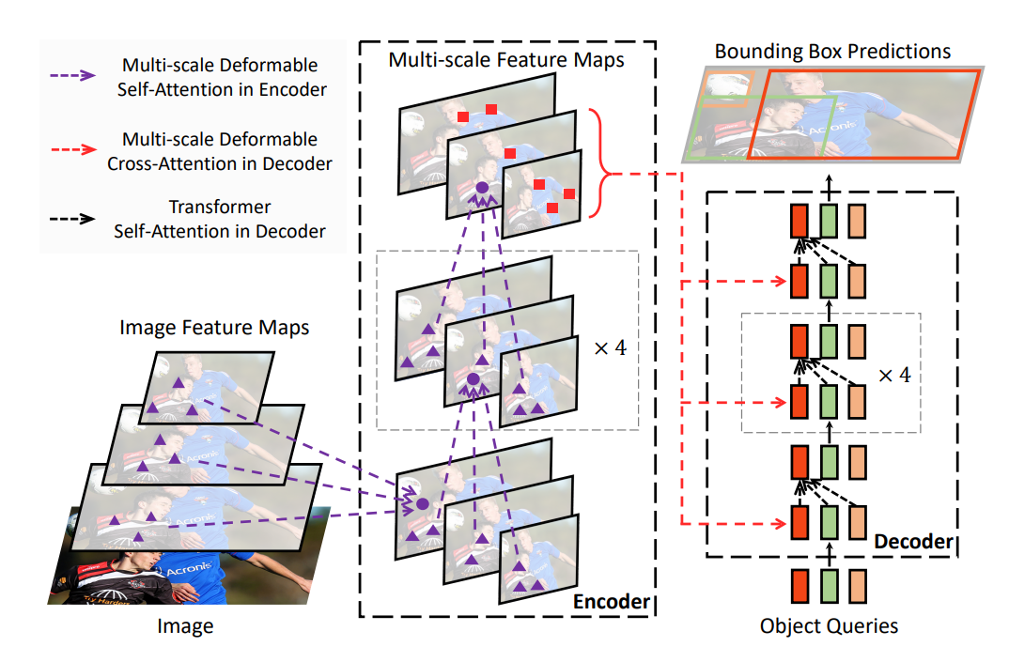
Architecture

Slide 9
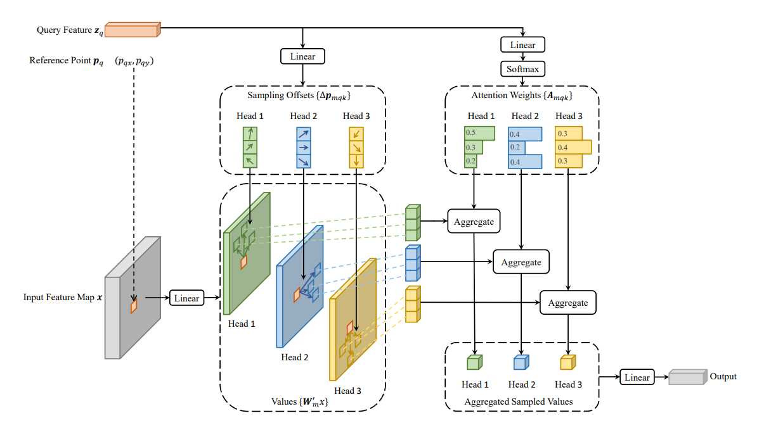
Deformable Attention Module

Slide 10
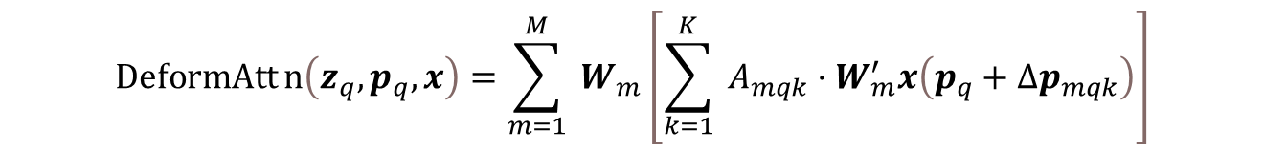

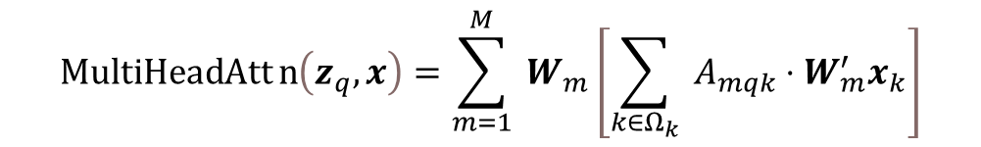
Method
$$MultiHeadAttn\left(z_{q},x\right)=\sum_{m=1}^{M}{ }W_{m}\left[\sum_{k∈Ω_{k}}{ }A_{mqk}⋅W_{m}^{′}x_{k}\right]$$
$$DeformAttn\left(z_{q},p_{q},x\right)=\sum_{m=1}^{M}{ }W_{m}\left[\sum_{k=1}^{K}{ }A_{mqk}⋅W_{m}^{′}x\left(p_{q}+Δp_{mqk}\right)\right]$$
$$MSDeformAttn\left(z_{q},{\hat{p}}_{q},{\left\{x^{l}\right\}}_{l=1}^{L}\right)=\sum_{m=1}^{M}{ }W_{m}\left[\sum_{l=1}^{L}{ }\sum_{k=1}^{K}{ }A_{mlqk}⋅W_{m}^{′}x^{l}\left(φ_{l}\left({\hat{p}}_{q}\right)+Δp_{mlqk}\right)\right]$$

Slide 11
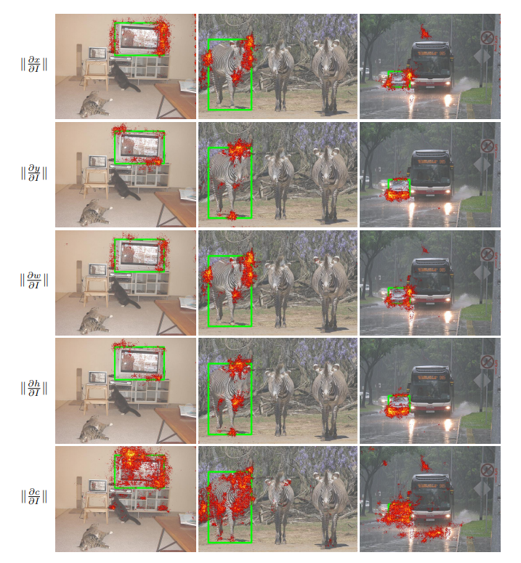
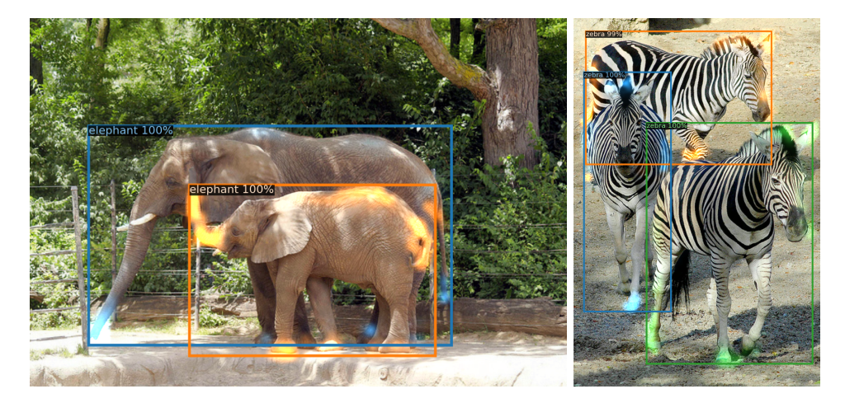
What deformable DETR looks at?

Slide 12
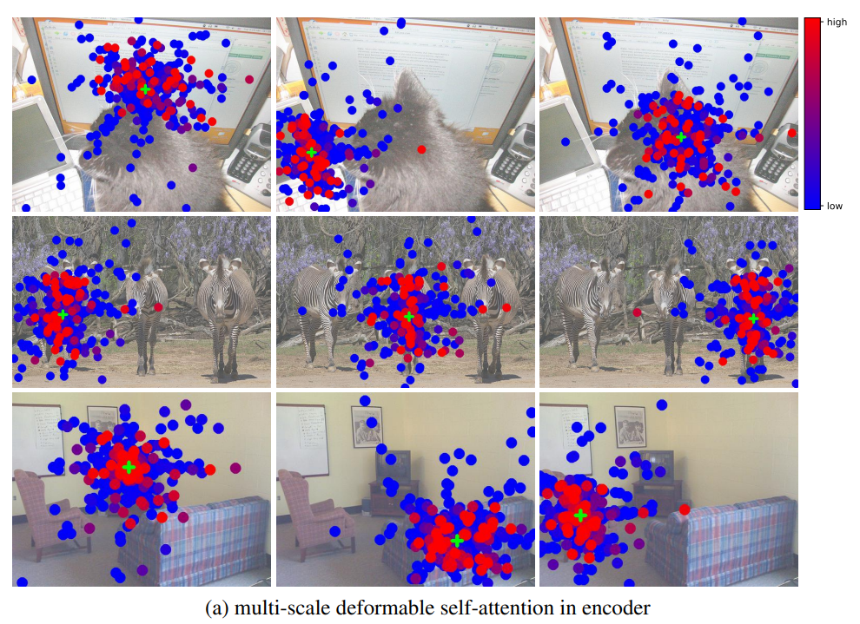
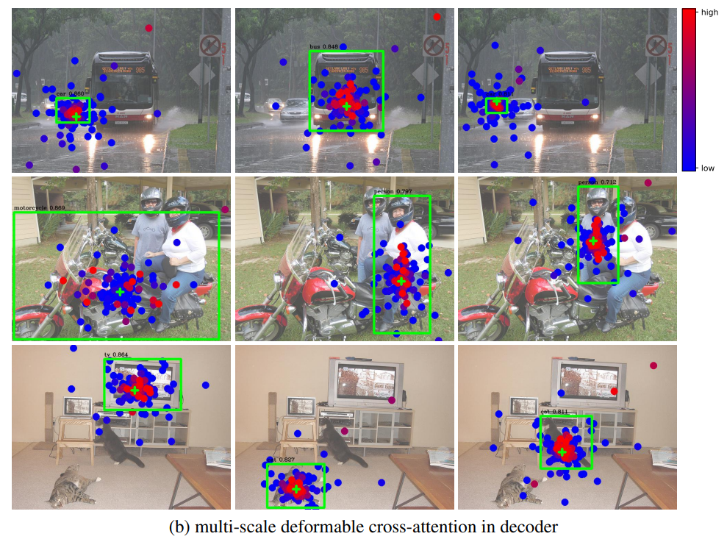
Visualization

Slide 13
04
EXPERIMENT

Slide 14
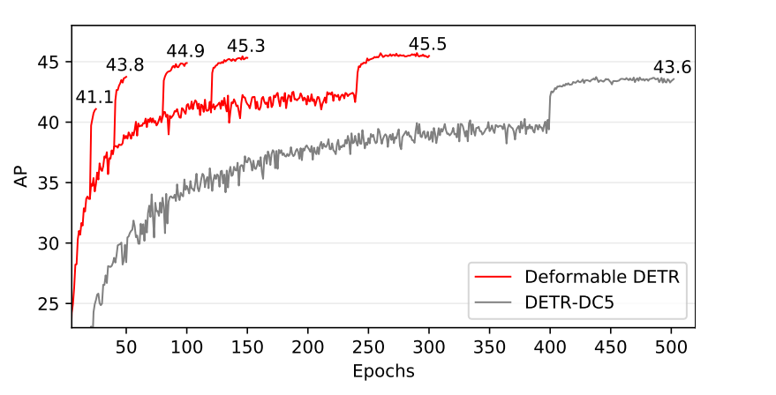
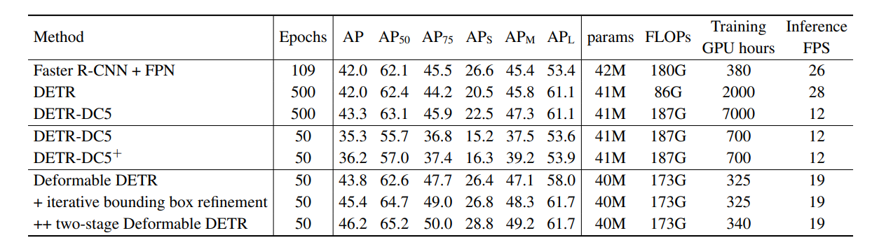
Experiment

Slide 15
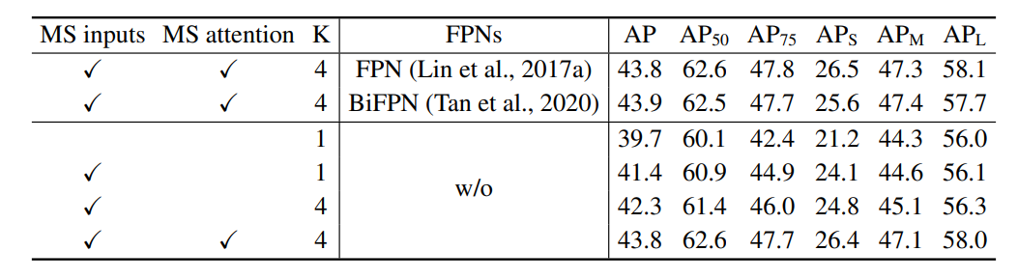
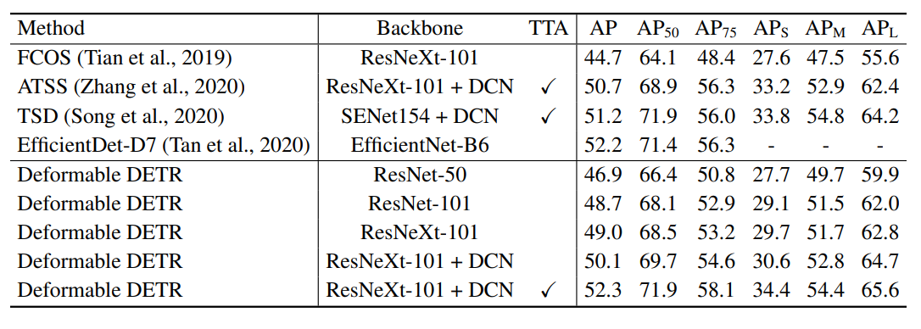
Experiment

Slide 16
05
CONCLUSION

Slide 17
Thanks for Your Attention
Q&A

